Slide 1
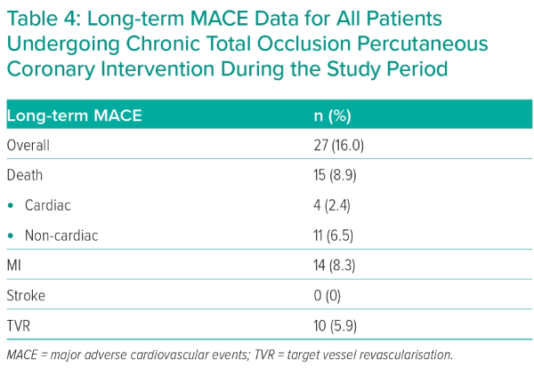
Gilpin TR, Maznyczka A, Anantharam B, Dana A
Long-term MACE Data for All Patients Undergoing Chronic Total Occlusion Percutaneous Coronary Intervention During the Study Period
Citation: Interventional Cardiology 2024;19:e05.
https://doi.org/10.15420/icr.2023.23

