Slide 1

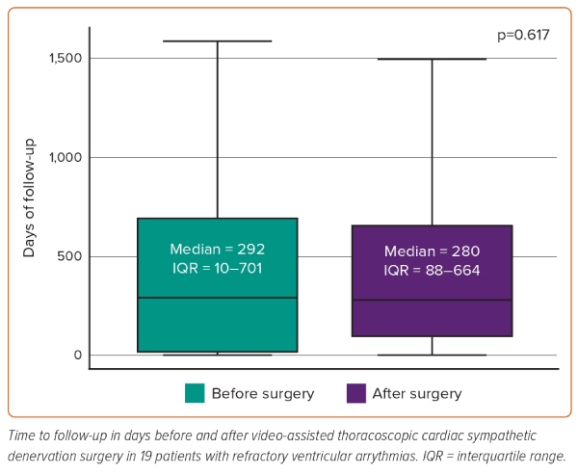
Álvarez-Ortega C, Gómez-Martínez JD, Cardona-Gallardo MA, Torres-España NF, Pava-Molano LF, Sánchez-Ortiz �I, Velásquez-Galvis M
Figure 3: Time to Follow-up
Citation: Interventional Cardiology 2024;19:e06.
https://doi.org/10.15420/icr.2023.09

