Slide 1
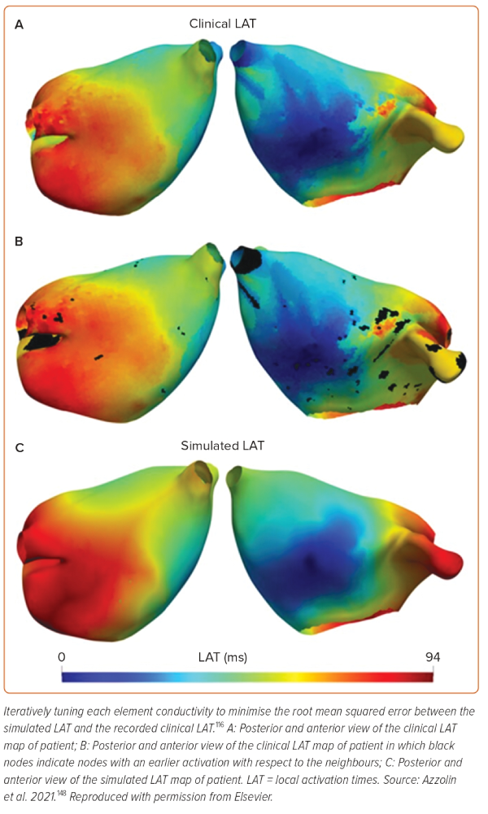
Jaffery OA, Melki L, Slabaugh G, Good WW, Roney CH
Figure 3: AugmentA: Patient-specific Atrial Model Calibration Using Activation Maps
Citation: Arrhythmia & Electrophysiology Review 2024;13:e08.
https://doi.org/10.15420/aer.2023.25

