Slide 1
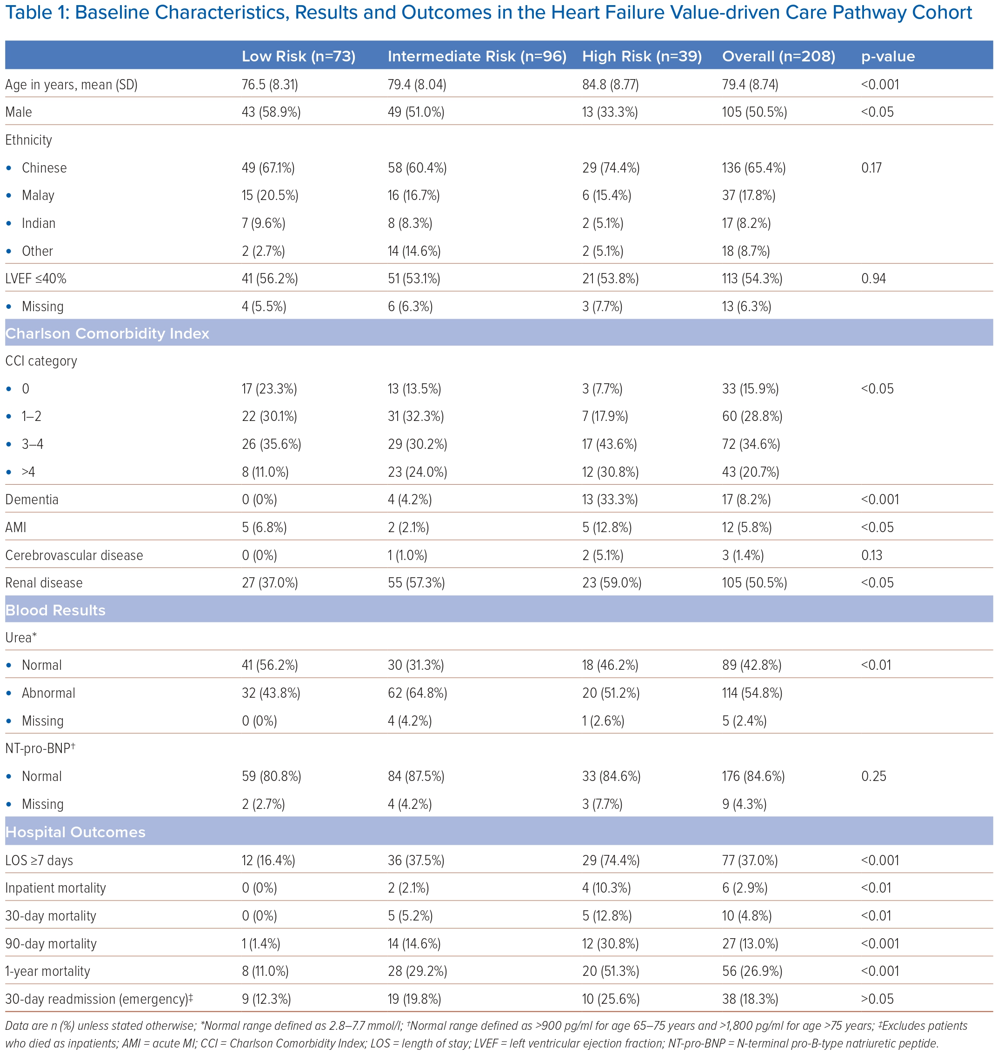
Teo Z, Oh YZ, Huang W, Lee S, Chang TY, Lim A, Sim LE, Del Valle Espelata W, Conroy S, Rosario BH
Baseline Characteristics, Results and Outcomes in the Heart Failure Value-driven Care Pathway Cohort
Citation: Journal of Asian Pacific Society of Cardiology 2024;3:e16.
https://doi.org/10.15420/japsc.2023.38

