Slide 1

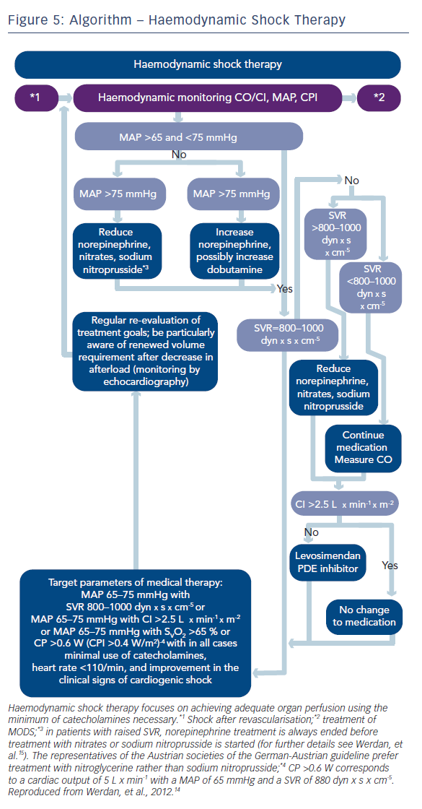
Werdan K, Russ M, Buerke M, Prondzinsky R, Dietz S
Evidence-based Management of Cardiogenic Shock After Acute Myocardial Infarction
Citation: Interventional Cardiology Review 2013;8(2):73-80
https://doi.org/10.15420/icr.2013.8.2.73

