Slide 1
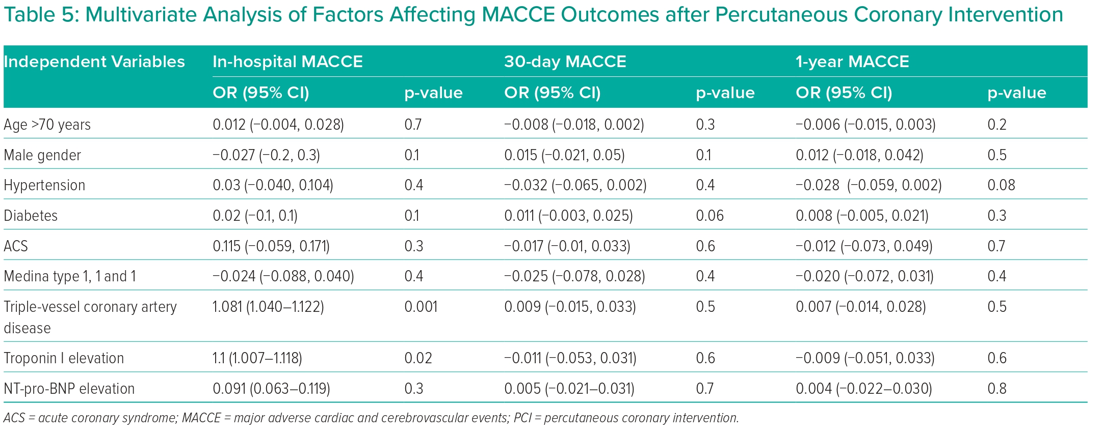
Le DCP, Bui HT, Vo QD
Multivariate Analysis of Factors Affecting MACCE Outcomes after Percutaneous Coronary Intervention
Citation: Interventional Cardiology 2024;19:e08.
https://doi.org/10.15420/icr.2023.37

