Slide 1
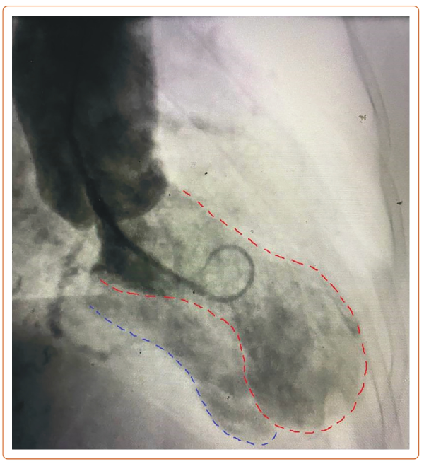
Kaur A, Patel Y, Tamis-Holland J
Figure 1: Left Ventriculogram Showing Filling of Left Ventricle (Red) as well as Right Ventricle (Blue)
Citation: US Cardiology Review 2024;18:e06.
https://doi.org/10.15420/usc.2024.01

