Slide 1
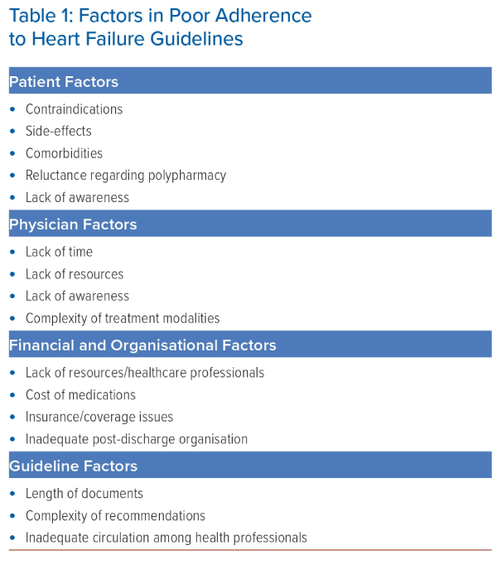
Komajda M
Factors in Poor Adherence to Heart Failure Guidelines
Citation: Journal of Asian Pacific Society of Cardiology 2024;3:e19.
https://doi.org/10.15420/japsc.2024.08

