Slide 1
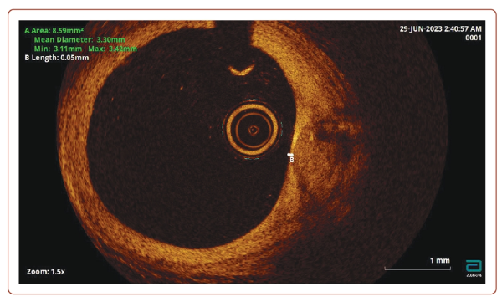
Bikbaeva G, Kovalskaya A, Rodin A, Pavlova T, Duplyakov D
Figure 2: Unstable Plaque on Optical Coherence Tomography
Citation: Journal of Asian Pacific Society of Cardiology 2024;3:e20.
https://doi.org/10.15420/japsc.2023.35

