Slide 1
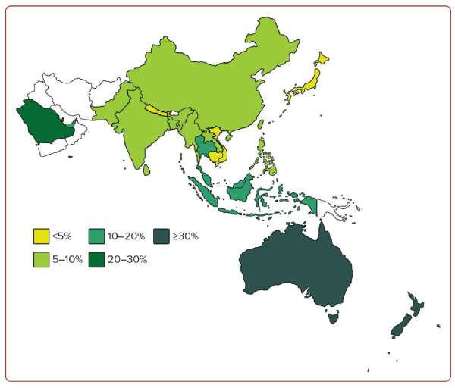
Lui DTW, Ako J, Dalal JJ, Fong AYY, Fujino M, Horton A, Krittayaphong R, Almahmeed W, Matthias AT, Nelson A, Nicholls S, O’Brien R, Poh KK, Soomro K, Yeo KK, Tan KCB
Figure 1: Prevalence of Obesity in the Asia-Pacific Region (Based on BMI ≥30 kg/m2 )
Citation: Journal of Asian Pacific Society of Cardiology 2024;3:e21.
https://doi.org/10.15420/japsc.2023.68

