Slide 1
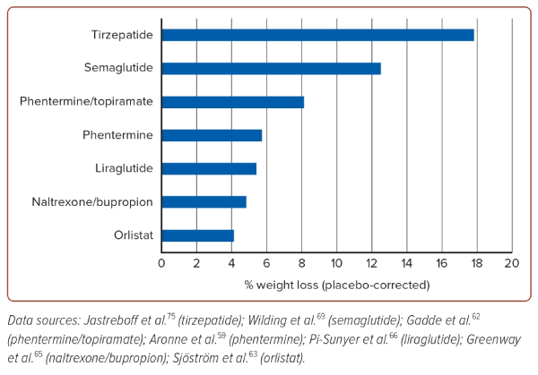
Lui DTW, Ako J, Dalal JJ, Fong AYY, Fujino M, Horton A, Krittayaphong R, Almahmeed W, Matthias AT, Nelson A, Nicholls S, O’Brien R, Poh KK, Soomro K, Yeo KK, Tan KCB
Figure 2: Placebo-corrected Percentage Weight Loss Achieved with Maximum Dose of Anti-obesity Pharmacotherapies
Citation: Journal of Asian Pacific Society of Cardiology 2024;3:e21.
https://doi.org/10.15420/japsc.2023.68

