Slide 1
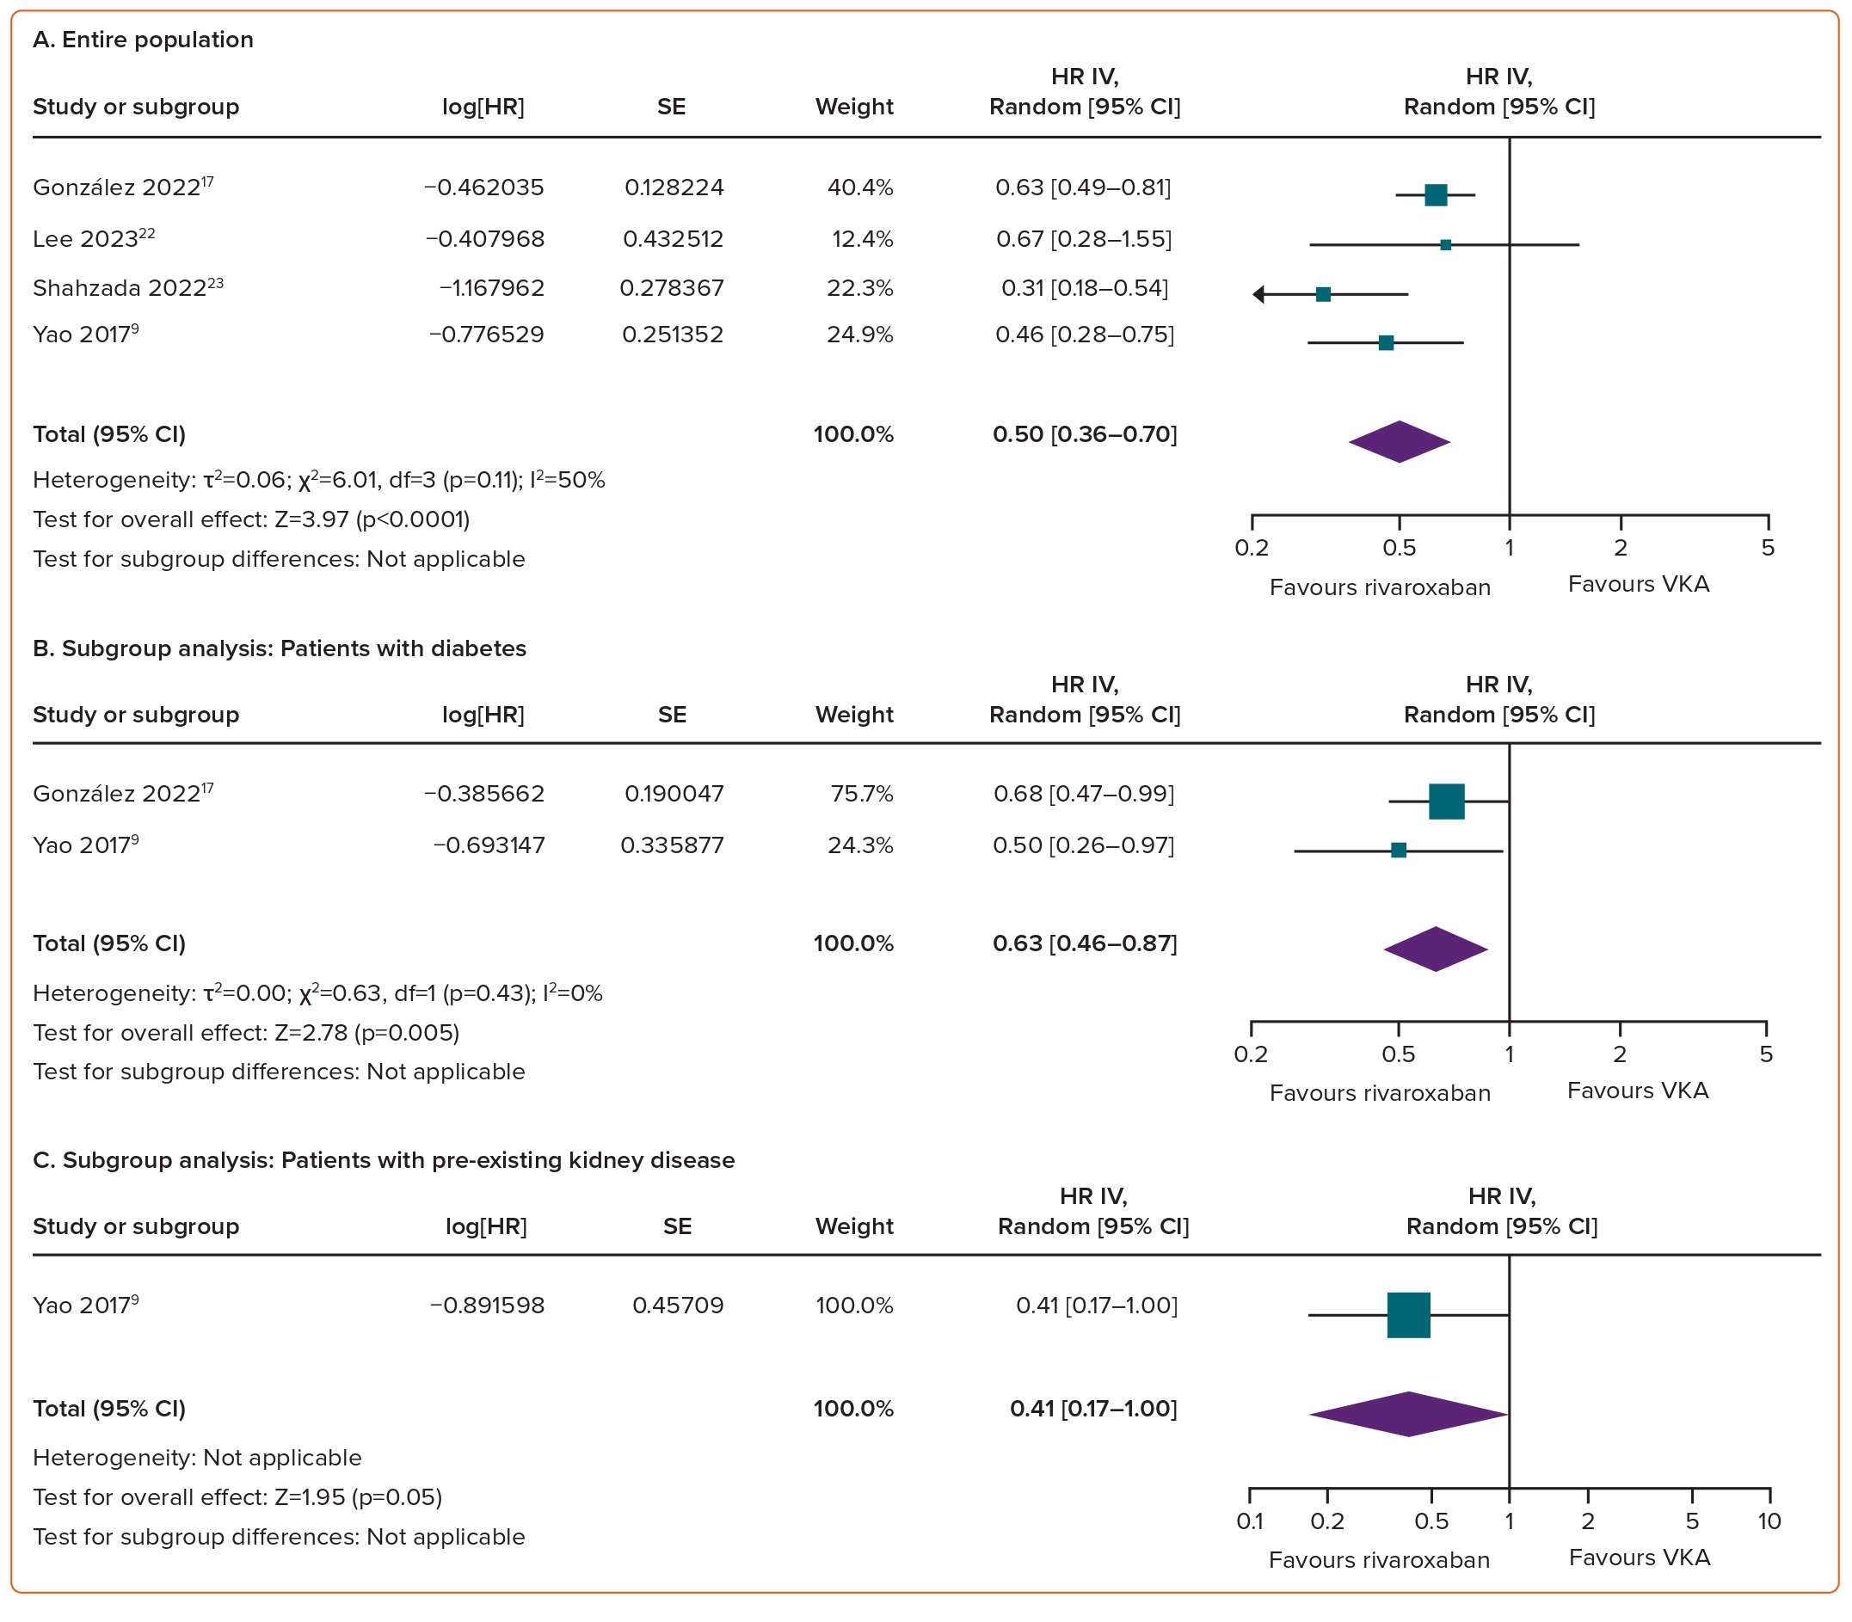
Dinh PP, Ho THQ, Pham HM, Nguyen H, Ton MT, Tran GS, Vu NQ, Pham HN, Cao SL, Hoang SV
Figure 4: Comparison of Rivaroxaban and Vitamin K Antagonists on the Risk of Serum Creatinine Levels Doubling Among AF Patients
Citation: European Cardiology Review 2024;19:e05.
https://doi.org/10.15420/ecr.2024.07

