Slide 1
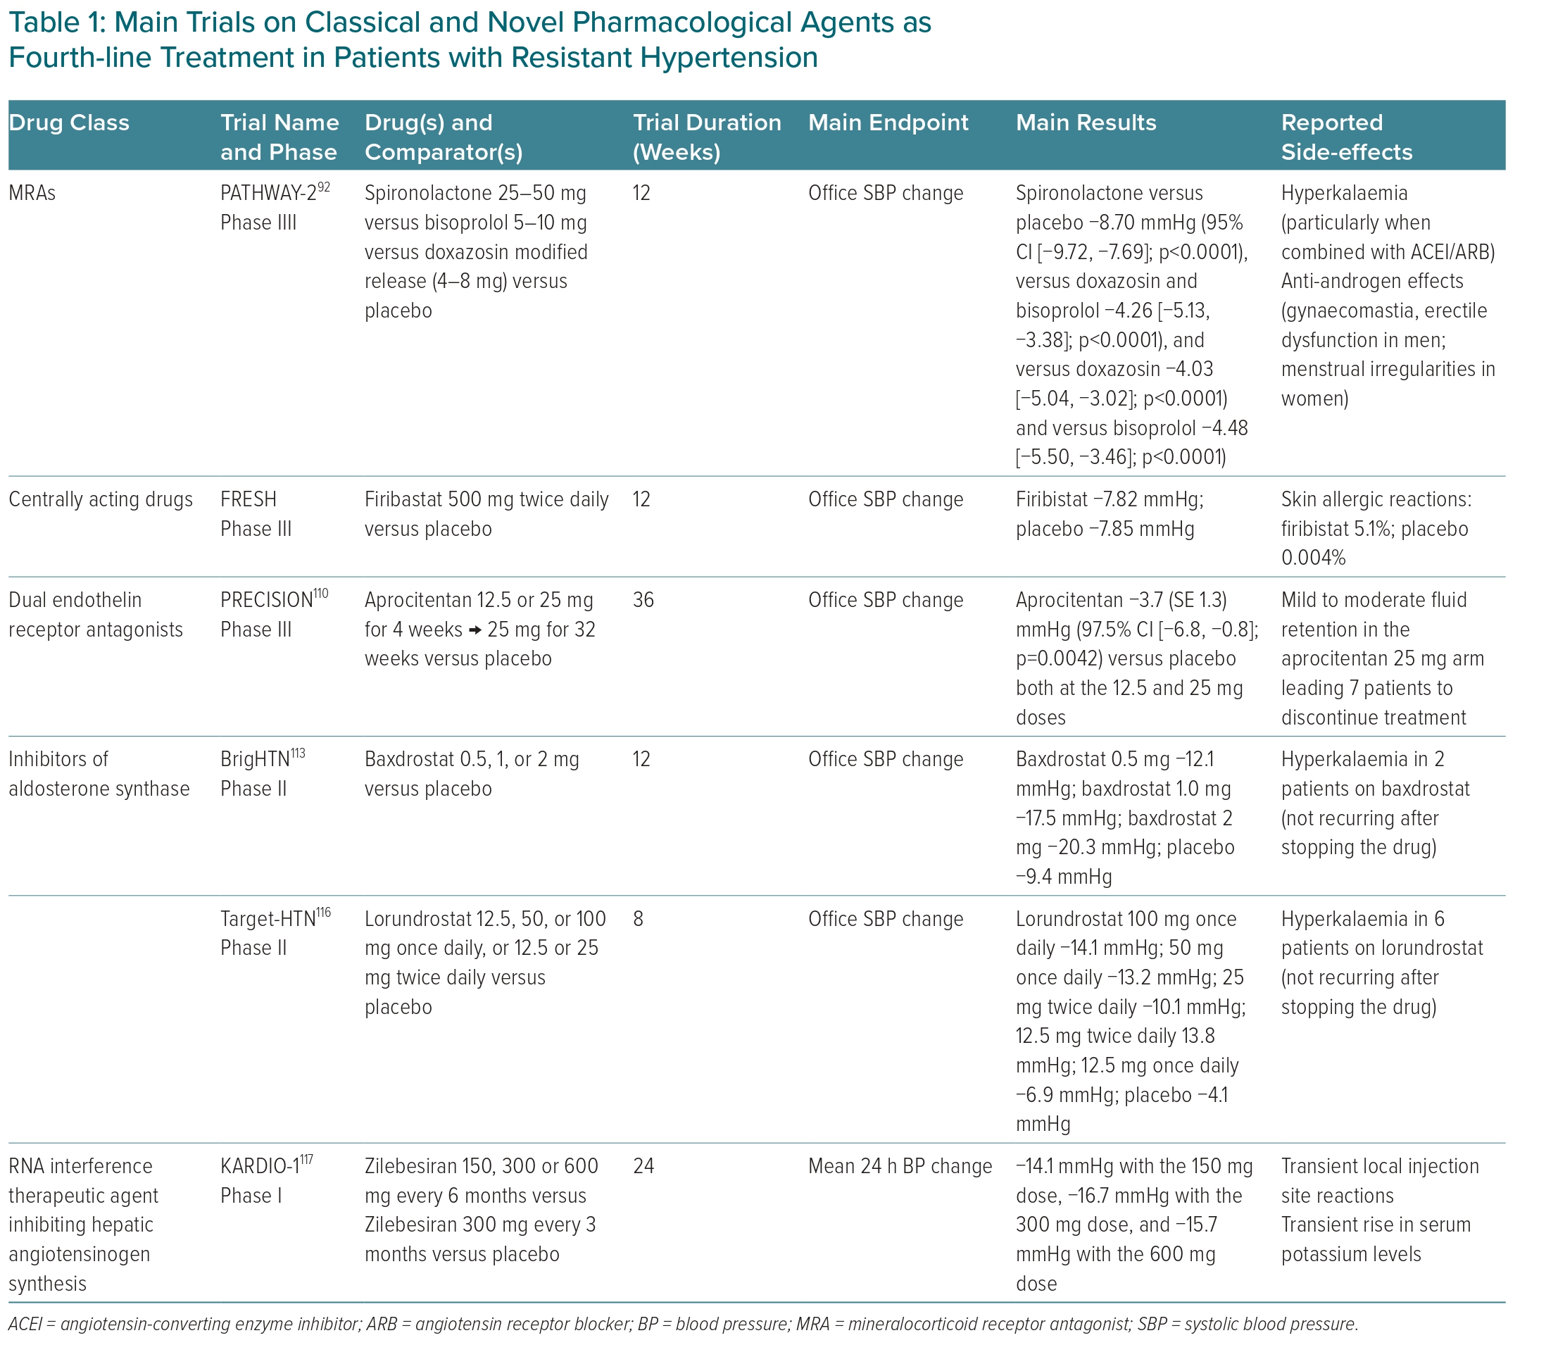
Buso G, Agabiti-Rosei C, Lemoli M, Corvini F, Muiesan ML
Main Trials on Classical and Novel Pharmacological Agents as Fourth‑line Treatment in Patients with Resistant Hypertension
Citation: European Cardiology Review 2024;19:e07.
https://doi.org/10.15420/ecr.2023.51

