Slide 1
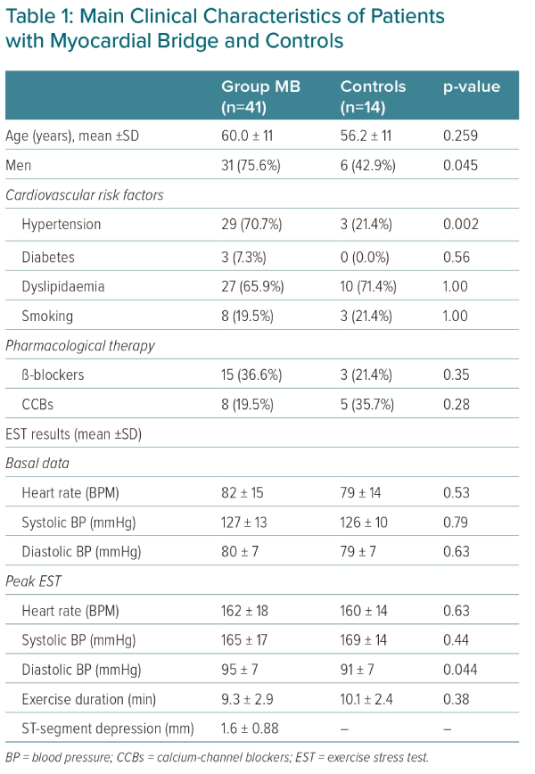
Lamendola P, Cambise N, Di Renzo A, Tinti L, De Vita A, Tremamunno S, Pastena P, Belmusto A, Montone RA, Rinaldi R, Villano A, Lanza GA
Main Clinical Characteristics of Patients with Myocardial Bridge and Controls
Citation: European Cardiology Review 2024;19:e09.
https://doi.org/10.15420/ecr.2024.03

