Slide 1
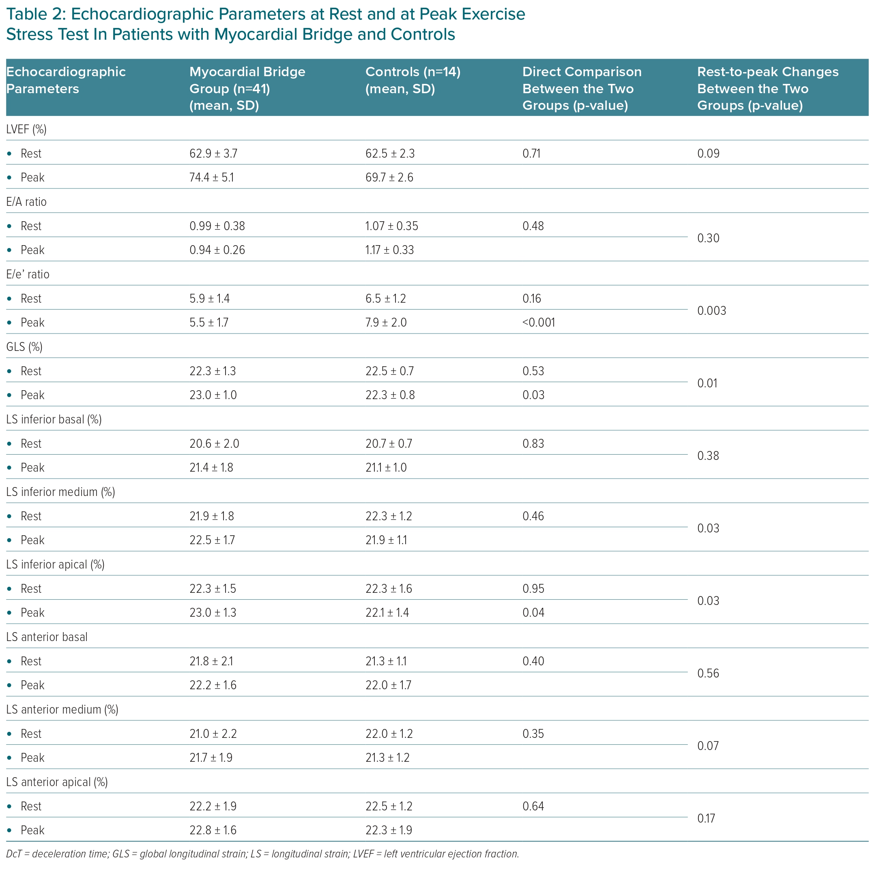
Lamendola P, Cambise N, Di Renzo A, Tinti L, De Vita A, Tremamunno S, Pastena P, Belmusto A, Montone RA, Rinaldi R, Villano A, Lanza GA
Echocardiographic Parameters at Rest and at Peak Exercise Stress Test In Patients with Myocardial Bridge and Controls
Citation: European Cardiology Review 2024;19:e09.
https://doi.org/10.15420/ecr.2024.03

