Slide 1
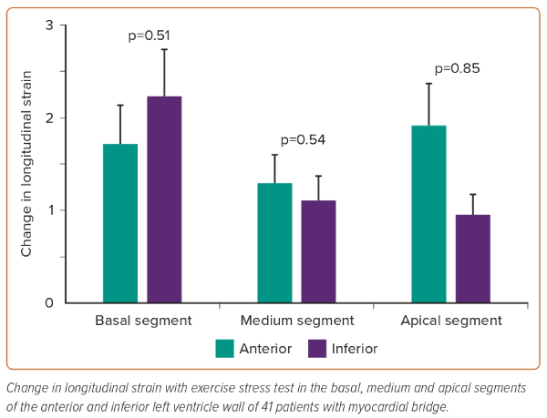
Lamendola P, Cambise N, Di Renzo A, Tinti L, De Vita A, Tremamunno S, Pastena P, Belmusto A, Montone RA, Rinaldi R, Villano A, Lanza GA
Figure 1: Change in Longitudinal Strain with Exercise Stress Test
Citation: European Cardiology Review 2024;19:e09.
https://doi.org/10.15420/ecr.2024.03

