Slide 1
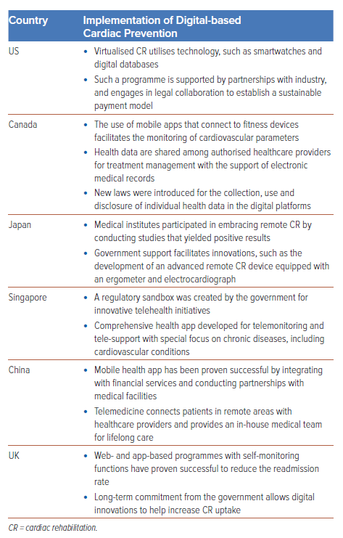
Dwiputra B, Ambari AM, Desandri DR, Fatrin S, Zuhdi N, Radi B
Table 1: Examples of Digital-based Cardiac Prevention in Different Countries
Citation: Journal of Asian Pacific Society of Cardiology 2024;3:e24.
https://doi.org/10.15420/japsc.2023.46

