Slide 1
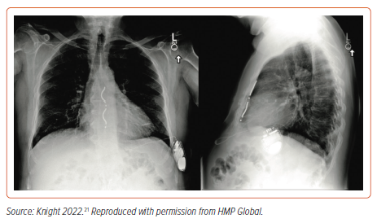
Foley P, Thomas H, Dayer M, Robinson S, Ezzatt V, Swift M, Johal N, Roberts E
Figure 2: Anterior–Posterior Chest Radiograph of a Subcutaneous Implantable Defibrillator
Citation: Arrhythmia & Electrophysiology Review 2024;13:e10.
https://doi.org/10.15420/aer.2024.01

