Slide 1
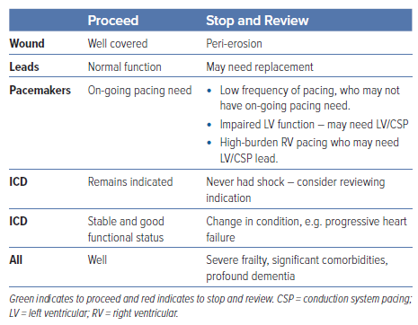
Foley P, Thomas H, Dayer M, Robinson S, Ezzatt V, Swift M, Johal N, Roberts E
Table 4: Decision Aid to Guide Determining Patients Suitable for Listing for a Box Change and Those who Require Pre-procedure Clinical Review
Citation: Arrhythmia & Electrophysiology Review 2024;13:e10.
https://doi.org/10.15420/aer.2024.01

