Slide 1
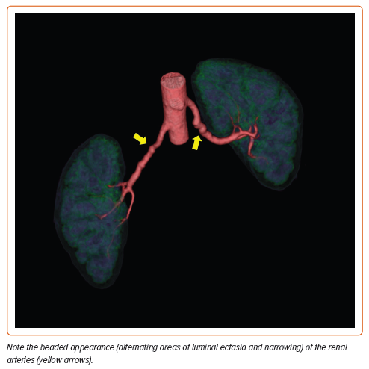
Khoury MH, Hershey S, LeLeiko RM
Figure 3: Volumetric Visualization of CT Angiography Data of a Patient with Renal Artery Fibromuscular Dysplasia
Citation: US Cardiology Review 2024;18:e08.
https://doi.org/10.15420/usc.2023.03

