Slide 1
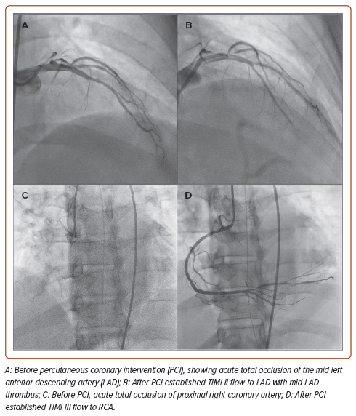
Kim HS, Tee Lu H
Figure 3: Coronary Angiogram Before and After Percutaneous Coronary Intervention
Citation: Journal of Asian Pacific Society of Cardiology 2024;3:e25.
https://doi.org/10.15420/japsc.2023.66

