Slide 1
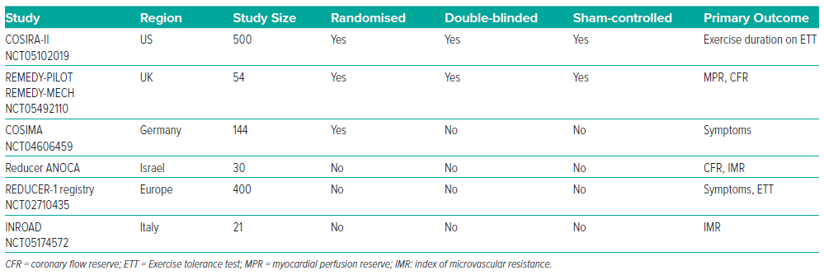
Cheng K, Hill JM, de Silva R
Table 1: Current Clinical Trials Investigating the Mechanism and Clinical Efficacy of Coronary Sinus Reducer Implantation
Citation: Interventional Cardiology Review 2024;19:e11.
https://doi.org/10.15420/icr.2023.45

