Slide 1
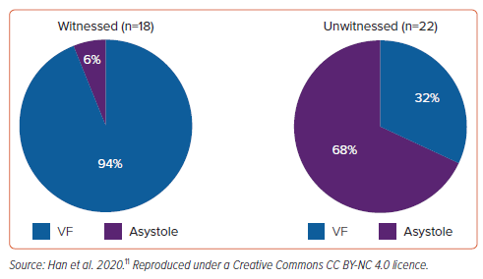
Cameron JN, Kadhim KI, Kamsani SH, Han HC, Farouque O, Sanders P, Lim HS
Figure 5: Initial Cardiac Rhythm in Cases of Autopsydetermined Isolated Mitral Valve Prolapse
Citation: Arrhythmia & Electrophysiology Review 2024;13:e11.
https://doi.org/10.15420/aer.2023.26

