Slide 1
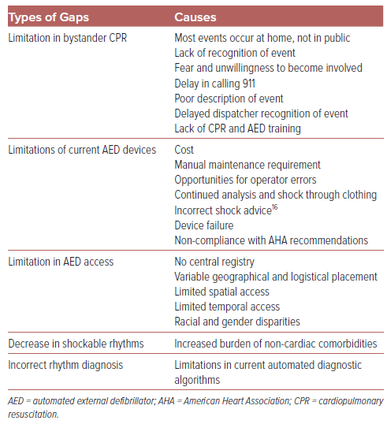
Shen C, Bhavnani SP, Rogers JD
Table 1: Gap Analysis
Citation: US Cardiology Review 2024;18:e09.
https://doi.org/10.15420/usc.2023.25

