Slide 1
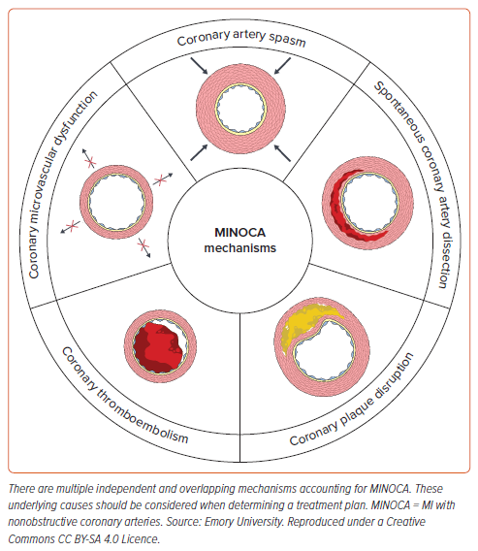
Fatade YA, Newman NA, Patel NH, Mehta PK
Figure 1: Mechanisms of MINOCA
Citation: US Cardiology Review 2024;18:e10.
https://doi.org/10.15420/usc.2023.12

