Slide 1
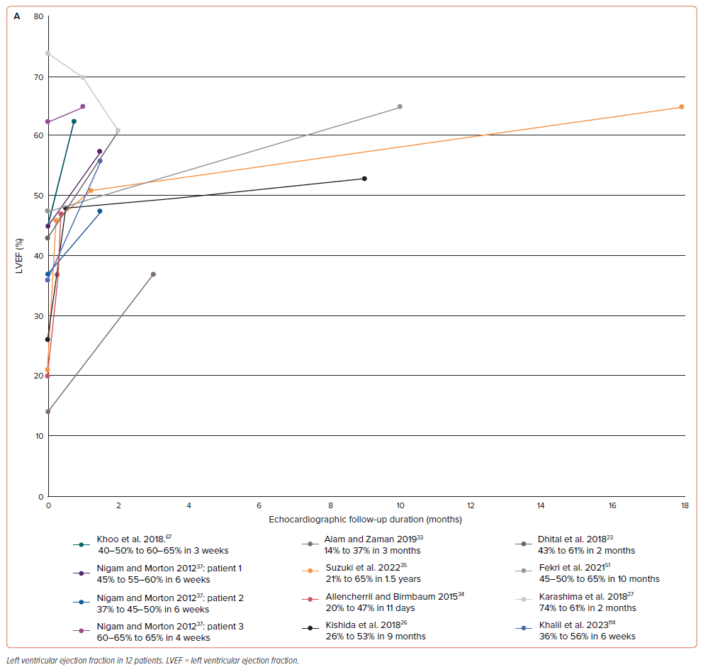
Witarto AP, Witarto BS, Pramudito SL, Ratri LC, Candra DA, Wirakasa S, Novida H, Susilo H, Wungu CDK, Kusumawati M
Figure 3A: Cardiac Follow-up Graphs Based on Echocardiographic Assessment
Citation: European Cardiology Review 2024;19:e13.
https://doi.org/10.15420/ecr.2024.05

