Slide 1
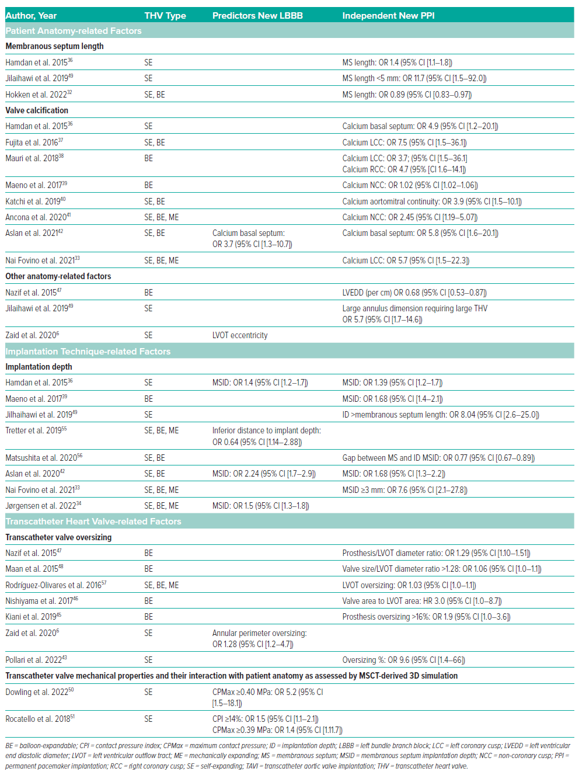
Nuis RJ, Dorpel Mvd, Adrichem R, Daemen J, Van Mieghem NM
Table 1: Patient Anatomy, Implantation Technique and Transcatheter Valverelated Predictors of New LBBB and PPI after TAVI
Citation: Interventional Cardiology 2024;19:e12.
https://doi.org/10.15420/icr.2024.11

