Slide 1

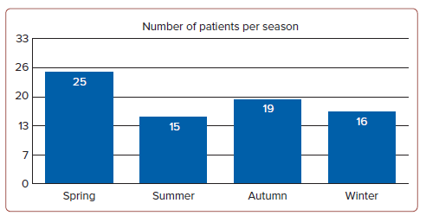
Watanabe S
Figure 1: Number of Patients in Each Season
Citation: Journal of Asian Pacific Society of Cardiology 2024;3:e33.
https://doi.org/10.15420/japsc.2024.17

