Slide 1
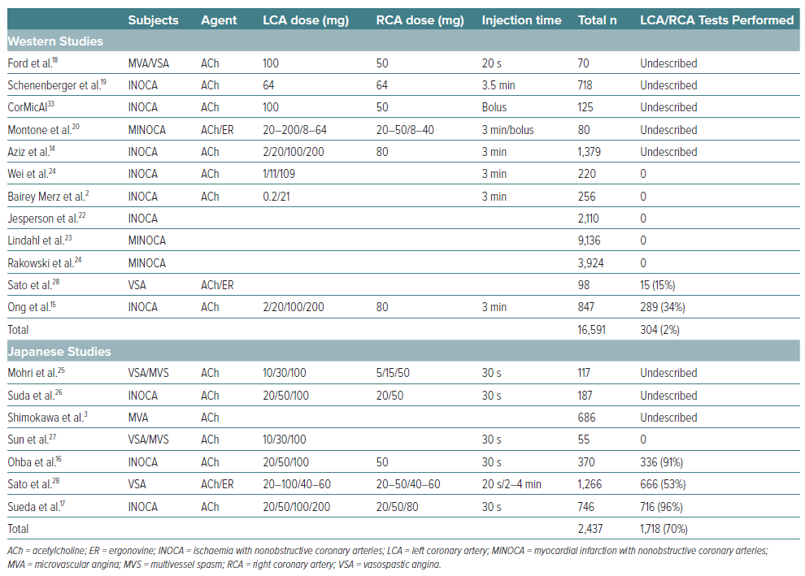
Sueda S, Sakaue T
Table 2: Vasoreactivity Testing on Both Coronary Arteries
Citation: European Cardiology Review 2024;19:e16.
https://doi.org/10.15420/ecr.2022.12

