Slide 1
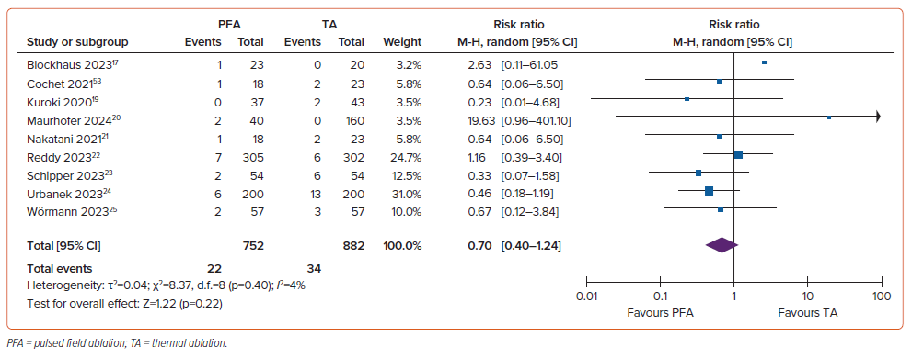
Iqbal M, Kamarullah W, Pranata R, Santosa Putra IC, Karwiky G, Achmad C, Young-Hoon K
Figure 6: Comparison of Periprocedural Complications Between the Pulsed Field Ablation and Control (Thermal Ablation) Groups
Citation: Arrhythmia & Electrophysiology Review 2024;13:e13.
https://doi.org/10.15420/aer.2024.05

