Slide 1
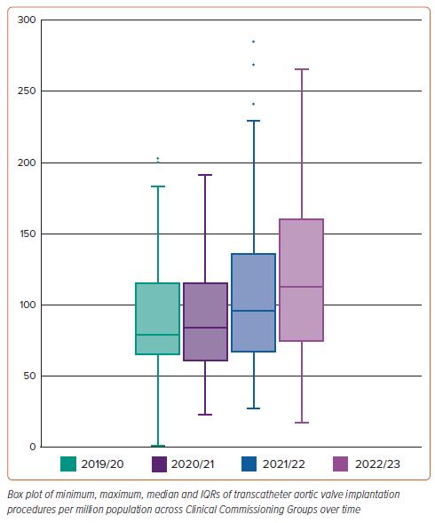
Aktaa S, Ali N, Ludman PF, Curzen N, Goodwin AT, Hildick-Smith D, Kharbanda R, Jones PD, Manuel S, Phanthala S, Blackman DJ
Figure 1: Transcatheter Aortic Valve Implantation Rates Per Million Population Across All Clinical Commissioning Groups in England between 2019 and 2023
Citation: Interventional Cardiology 2024;19:e15.
https://doi.org/10.15420/icr.2024.19

