Slide 1
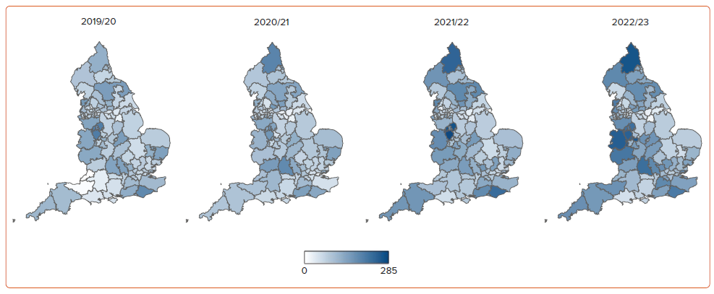
Aktaa S, Ali N, Ludman PF, Curzen N, Goodwin AT, Hildick-Smith D, Kharbanda R, Jones PD, Manuel S, Phanthala S, Blackman DJ
Figure 2: Transcatheter Aortic Valve Implantation Rates per Million Population in England across Individual Clinical Commissioning Groups between 2019/20 and 2022/23
Citation: Interventional Cardiology 2024;19:e15.
https://doi.org/10.15420/icr.2024.19

