Slide 1
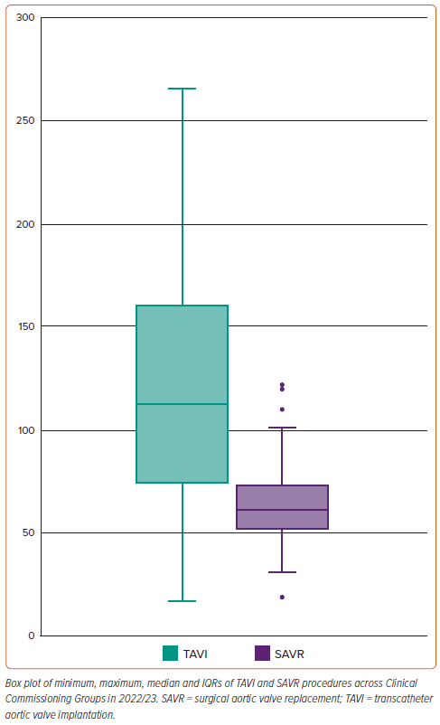
Aktaa S, Ali N, Ludman PF, Curzen N, Goodwin AT, Hildick-Smith D, Kharbanda R, Jones PD, Manuel S, Phanthala S, Blackman DJ
Figure 4: Rates of Transcatheter Aortic Valve Implantation and Surgical Aortic Valve Replacement Per Million Population Across All Clinical Commissioning Groups in England in 2022/23
Citation: Interventional Cardiology 2024;19:e15.
https://doi.org/10.15420/icr.2024.19

