Slide 1
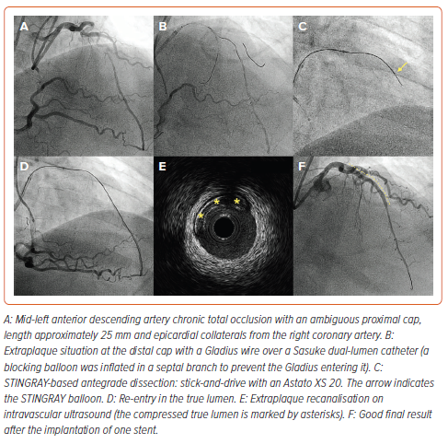
Masoomi R, Boukhris M, Moscardelli S, Azzalini L
Figure 2: STINGRAY-based Chronic Total Occlusion Recanalization
Citation: Interventional Cardiology 2024;19:e16.
https://doi.org/10.15420/icr.2024.04

