Slide 1
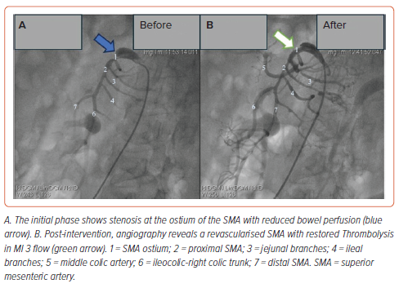
Le DCP, Bui HT, Vo QD
Figure 1: Superior Mesenteric Artery Angiography in Case 1
Citation: Interventional Cardiology 2024;19:e17.
https://doi.org/10.15420/icr.2024.09

