Slide 1

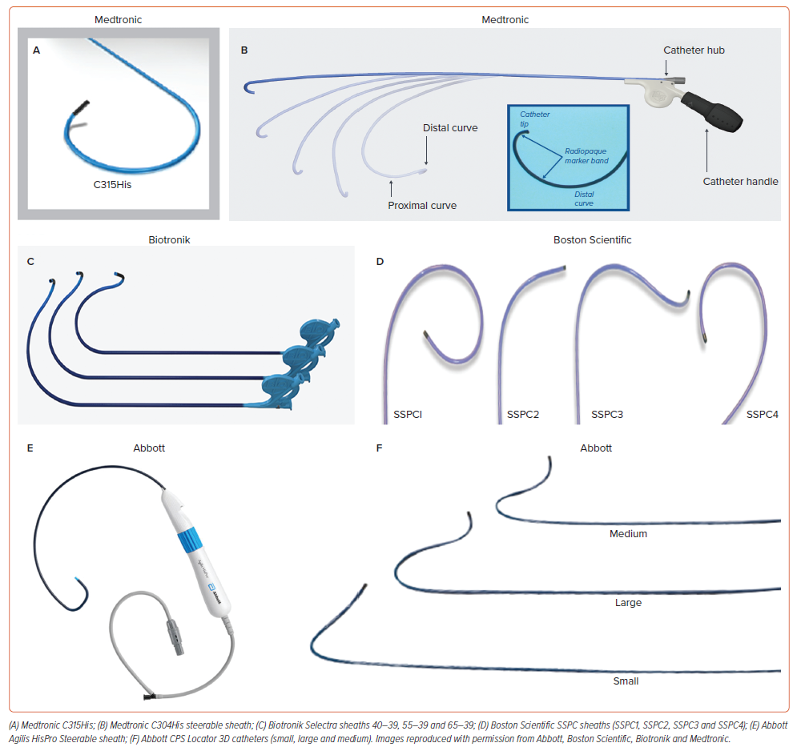
Cano �, De Pooter J, Zanon F
Figure 1: Commercially Available Sheaths for Conduction System Pacing
Citation: Arrhythmia & Electrophysiology Review 2024;13:e14.
https://doi.org/10.15420/aer.2024.18

