Slide 1

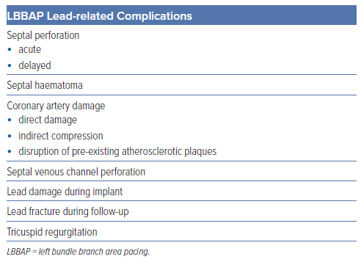
Cano �, De Pooter J, Zanon F
Table 3: Principal Complications Associated with Left Bundle Branch Area Pacing
Citation: Arrhythmia & Electrophysiology Review 2024;13:e14.
https://doi.org/10.15420/aer.2024.18

