Slide 1

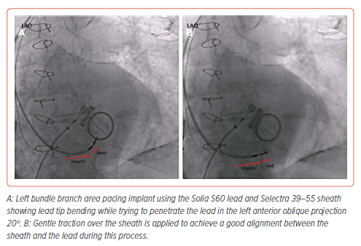
Cano �, De Pooter J, Zanon F
Figure 4: Importance of Lead–Sheath and Septal Alignment During Left Bundle Branch Area Pacing Using Stylet-driven Leads
Citation: Arrhythmia & Electrophysiology Review 2024;13:e14.
https://doi.org/10.15420/aer.2024.18

