Slide 1
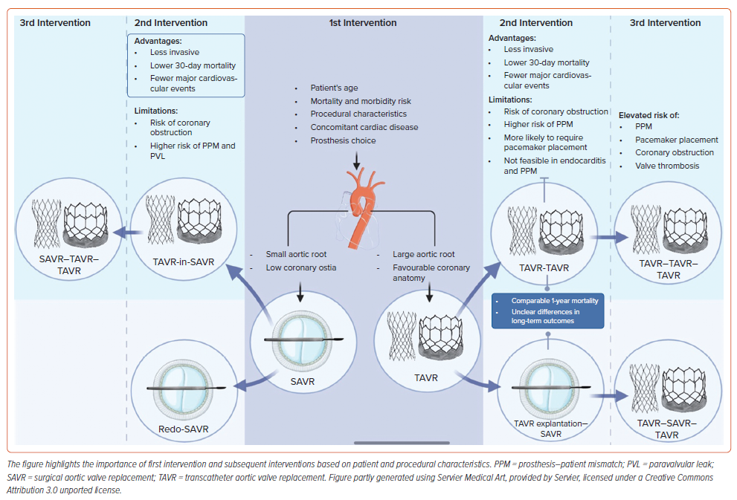
Jabri A, Alameh A, Giustino G, Gonzalez PE, O’Neill B, Bagur R, Cox P, Frisoli T, Lee J, Wang DD, O’Neill WW, Villablanca P
Figure 2: Lifetime Management Strategies in Transcatheter Aortic Valve Replacement
Citation: Cardiac Failure Review 2024;10:e11.
https://doi.org/10.15420/cfr.2023.23

