Slide 1
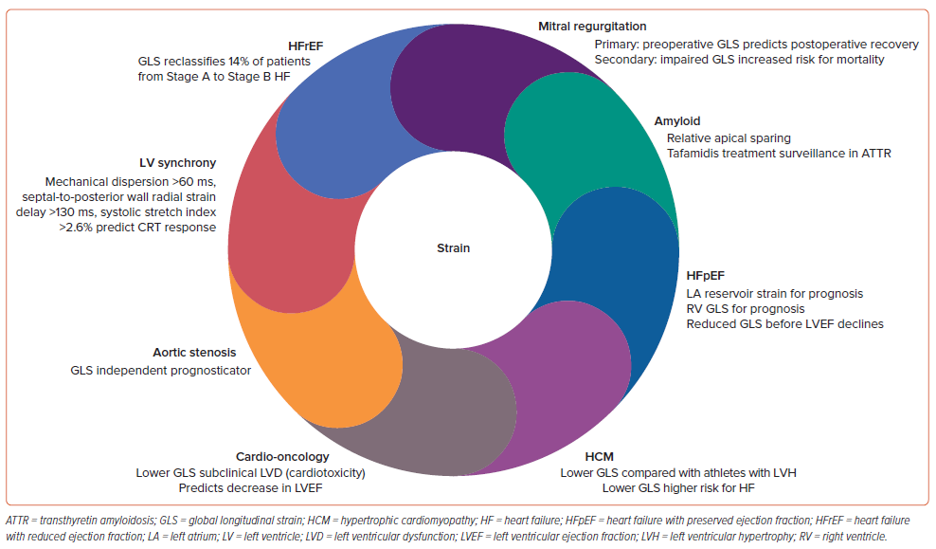
Thamman R, Hosseini N, Dikou ML, Hassan IU, Marchenko O, Abiola O, Grapsa J
Figure 6: Global Longitudinal Strain Imaging
Citation: Cardiac Failure Review 2024;10:e12.
https://doi.org/10.15420/cfr.2023.10

