Slide 1
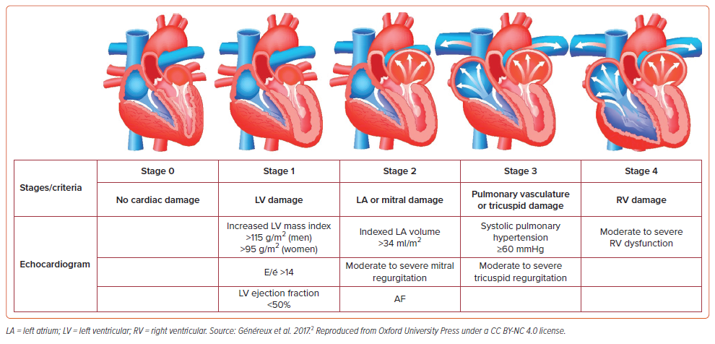
Silkowski M, Kendsersky P, Amoroso N
Figure 1: Cardiac Stratification of Aortic Stenosis Based on the Extent of Cardiac Damage
Citation: US Cardiology Review 2024;18:e16.
https://doi.org/10.15420/usc.2023.24

