Slide 1
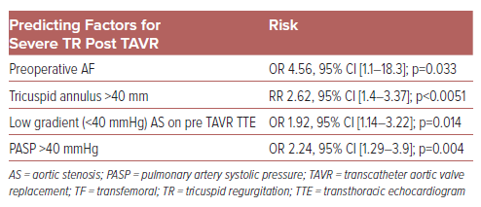
Silkowski M, Kendsersky P, Amoroso N
Table 1: Predicting Factors for Severe Tricuspid Regurgitation Post Transcatheter Aortic Valve Replacement1,8
Citation: US Cardiology Review 2024;18:e16.
https://doi.org/10.15420/usc.2023.24

