Slide 1
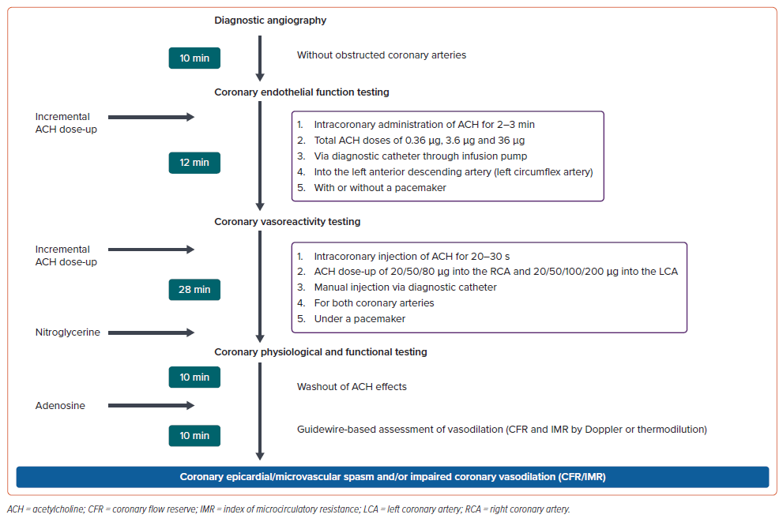
Sueda S, Sakaue T
Figure 2: Proposed Interventional Diagnostic Strategy Protocol
Citation: European Cardiology Review 2024;19:e17.
https://doi.org/10.15420/ecr.2022.16

