Slide 1
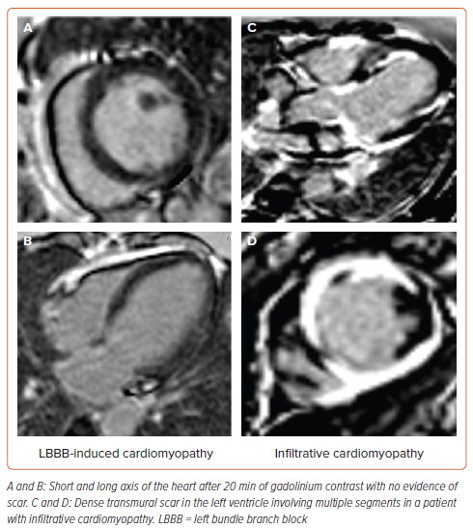
Ponnusamy SS, Vijayaraman P, Ellenbogen K
Figure 4: Cardiac MRI in Non-ischaemic Cardiomyopathy
Citation: Arrhythmia & Electrophysiology Review 2024;13:e15.
https://doi.org/10.15420/aer.2024.14

