Slide 1
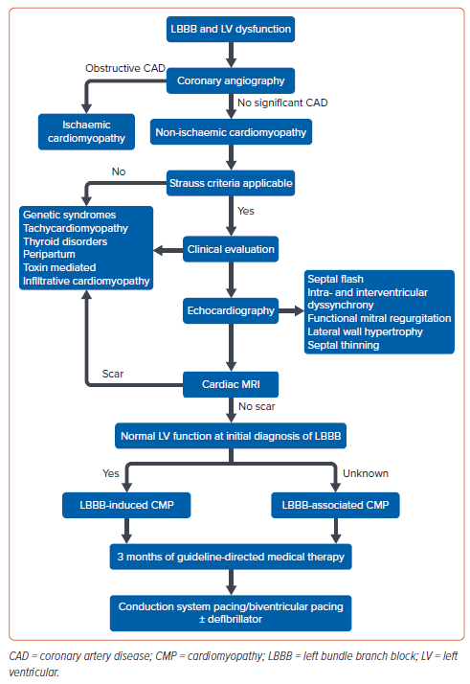
Ponnusamy SS, Vijayaraman P, Ellenbogen K
Figure 6: Approach to a Patient with Left Bundle Branch Block and Left Ventricular Dysfunction
Citation: Arrhythmia & Electrophysiology Review 2024;13:e15.
https://doi.org/10.15420/aer.2024.14

