Slide 1
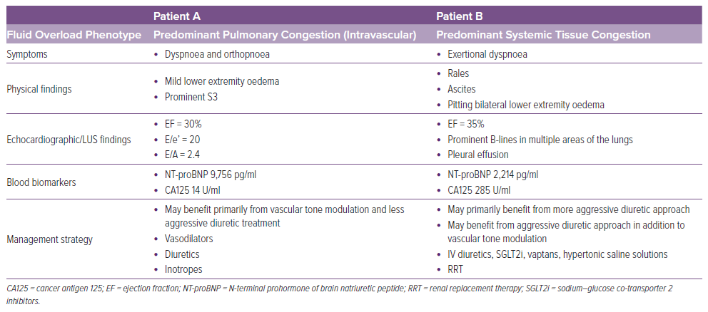
Kumric M, Kurir TT, Bozic J, Slujo AB, Glavas D, Miric D, Lozo M, Zanchi J, Borovac JA
Table 2: Comparison of Two Patients That Would Benefit from Congestion Phenotype Assessment
Citation: Cardiac Failure Review 2024;10:e13.
https://doi.org/10.15420/cfr.2024.07

