Slide 1
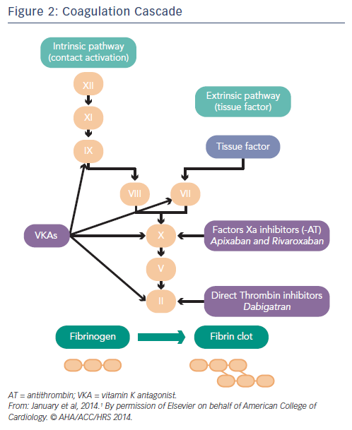
Katritsis DG, Gersh BJ, Camm AJ
Coagulation Cascade
Citation: Arrhythmia & Electrophysiology Review 2015;4(2):100–7
https://doi.org/10.15420/aer.2015.04.02.100

