Slide 1
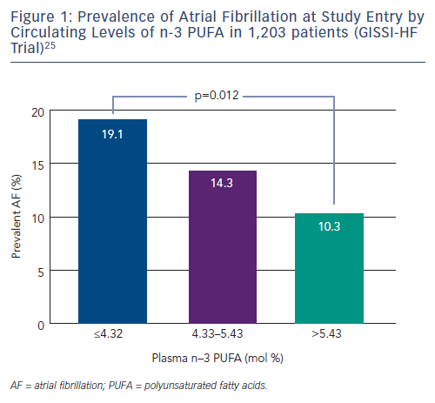
Orso F, Fabbri G, Maggioni AP
Prevalence of Atrial Fibrillation at Study Entry by Circulating Levels of n-3 PUFA in 1,203 patients (GISSI-HF Trial)25
Citation: Arrhythmia & Electrophysiology Review 2015;4(3):163–8
https://doi.org/10.15420/aer.2015.4.3.163

