Slide 1
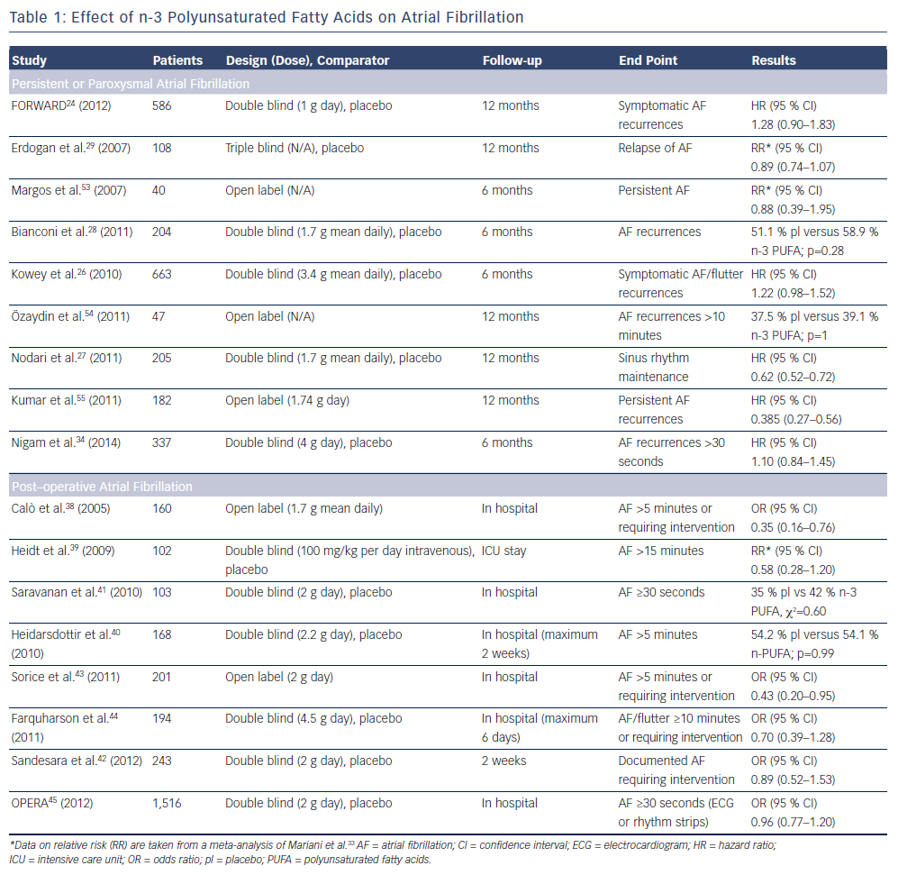
Orso F, Fabbri G, Maggioni AP
Effect of n-3 Polyunsaturated Fatty Acids on Atrial Fibrillation
Citation: Arrhythmia & Electrophysiology Review 2015;4(3):163–8
https://doi.org/10.15420/aer.2015.4.3.163

