Slide 1
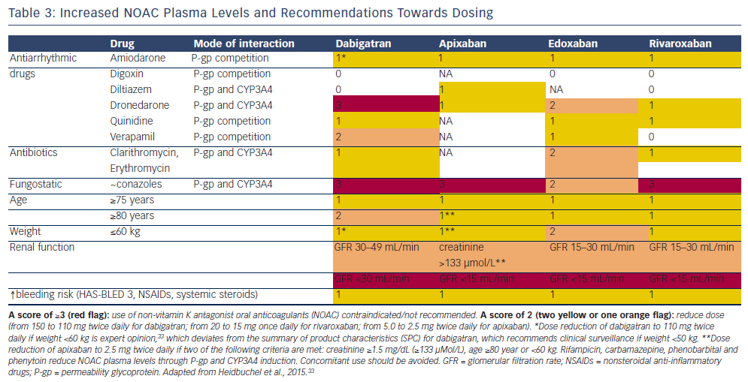
Alings M
Increased NOAC Plasma Levels and Recommendations Towards Dosing
Citation: Arrhythmia & Electrophysiology Review 2016;5(2):102–9
https://doi.org/10.15420/aer.20.3

